Slide 1
Increasing CO Gas Detections in Protoplanetary Disks
Grace Catherine Hathaway
Advisor: Dr. Kamber Schwarz
University of Arizona, Lunar and Planetary Laboratory
2021 Arizona Space Grant Symposium

Slide 2
Goal
Increase the number of CO detections by exploiting the Keplerian velocity structure of protoplanetary disks
Obtain a deeper understanding of the characteristics of protoplanetary disks
ALMA’s high-resolution images of nearby protoplanetary disks. Image credit: ALMA / ESO / NAOJ / NRAO / S. Andrews et al / AUI / NSF / S. Dagnello.

Slide 3
Background
Protoplanetary Disks
Planets are born by the gradual accumulation of dust and gas
Isotopologues ¹³CO and C¹⁸O are used as gas mass tracers to determine the gas-to-dust ratio of the disk
Interferometers
Artist rendering of the ALMA Array, in an extended configuration. © ALMA (ESO/NAOJ/NRAO)
66 antennas create an array equivalent to a single telescope with a diameter equal to the farthest distance between antennas (16km)
Combine radio waves captured from two or more antennas

Slide 4
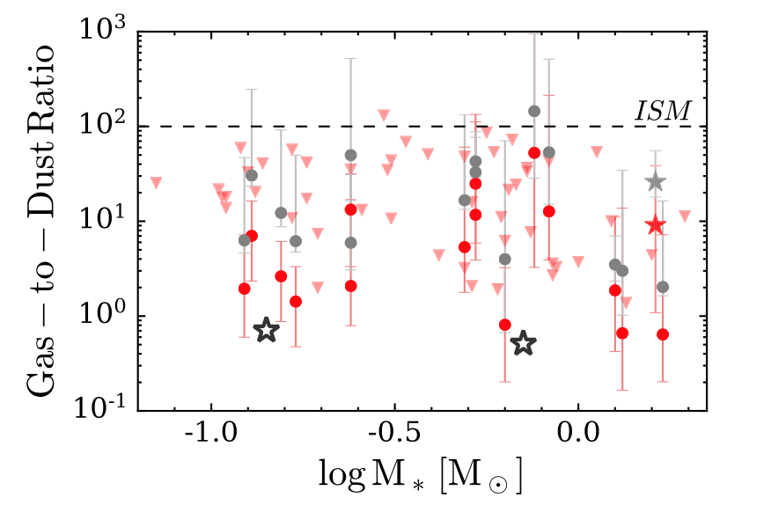
Background
Result of Previous Surveys
ALMA survey of CO emission towards disks in the star forming regions Lupus, Chameleon I, and Taurus
    Short integration time for each source
    CO gas was only detected towards brighter and more massive disks
    The gas masses inferred from CO detections are very low
Long et al. 2017
Black stars represent the average gas mass from stacking the CO images
The triangles represent upper limits

Slide 5
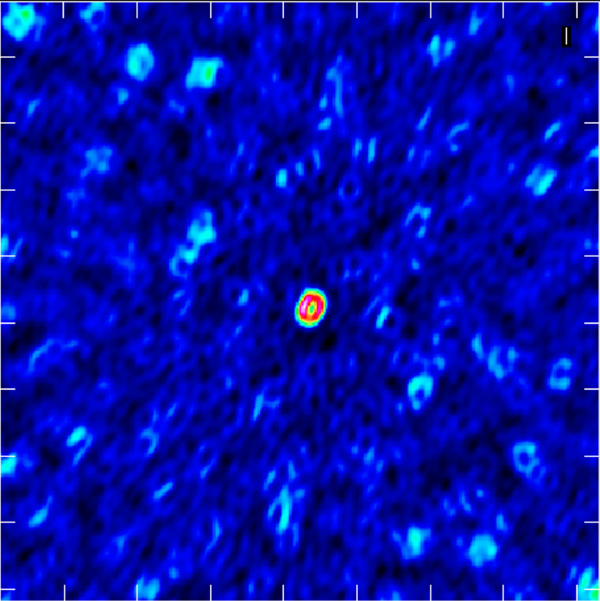
Methods
CASA
GoFish
The Common Astronomy Software Applications (CASA) is a software package to calibrate, image, and analyze radio astronomical data from interferometers
GoFish is a Python Package to exploit the known rotation of a protoplanetary disk
    Shift all emission to a common line center in order to stack them
    Increase the signal-to-noise of the spectrum
    Detect weaker lines
J10581677-7717170

Slide 6
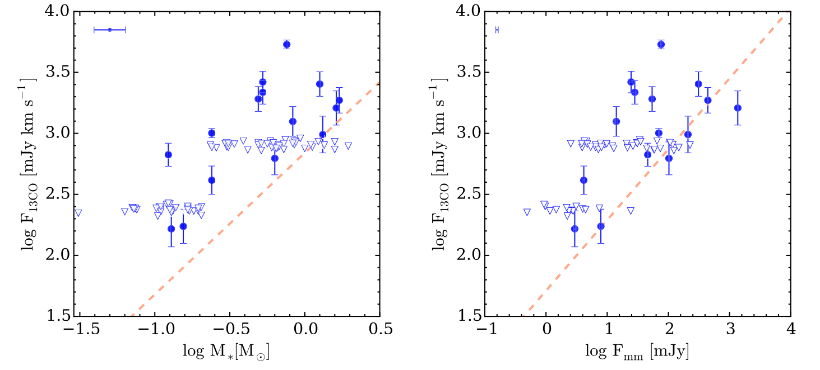
Methods
Long et al 2017
A paper published in 2017 by Long et al. used the same ALMA survey of sources in Chameleon as we did
Our goal is to expand upon their work here
6
7
8
10
9
12/13
14
15
16
Long et al. 2017

Slide 7
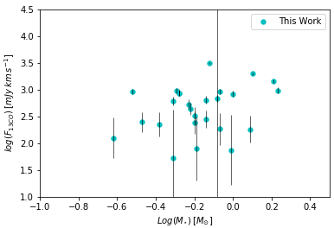
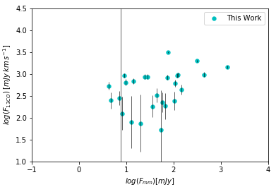
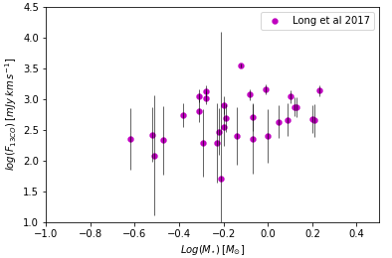
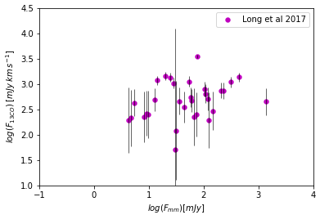
Results
¹³CO
Peak intensity obtained with GoFish is the same as in Long et al. but integrated intensity is higher
The higher signal to noise from GoFish lets us detect weaker emission
2 sources stayed undetected between GoFish and Long et al

Slide 8
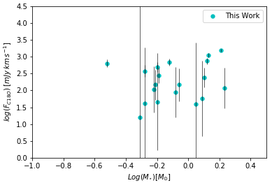
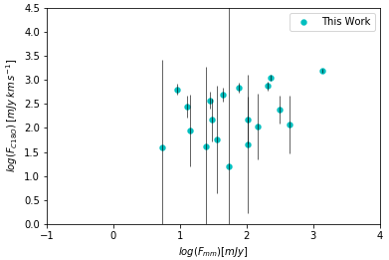
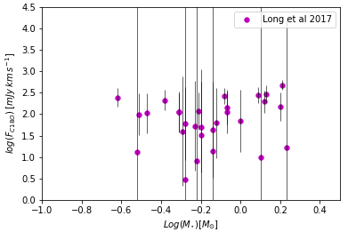
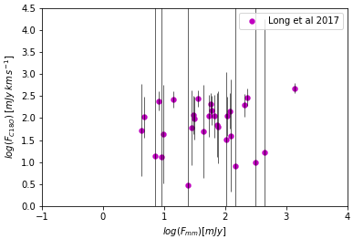
Results
C¹⁸O
3 sources stayed undetected between GoFish and Long et al
Next steps
    Repeat this whole process on the rest of the data
    Understand why detections in Long et al came out as non-detections with GoFish (different detection criteria)

Slide 9
Acknowledgments
Thanks to my advisor, Dr. Kamber Schwarz, for all her support
Thanks to Michelle Coe for orchestrating this internship and symposium
The material contained in this document is based upon work supported by a National Aeronautics and Space Administration (NASA) grant or cooperative agreement. Any opinions, findings, conclusions or recommendations expressed in this material are those of the author and do not necessarily reflect the views of NASA. This work was supported through a NASA grant awarded to the Arizona/NASA Space Grant Consortium.

